Slide 1
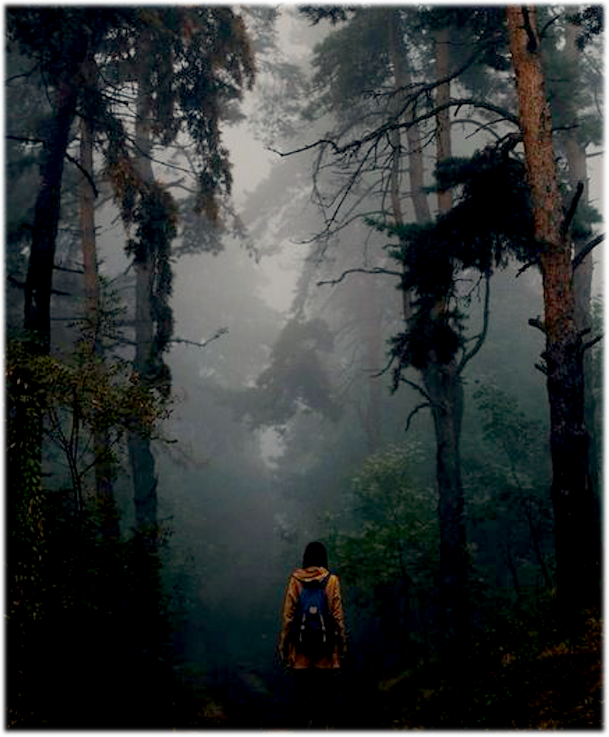
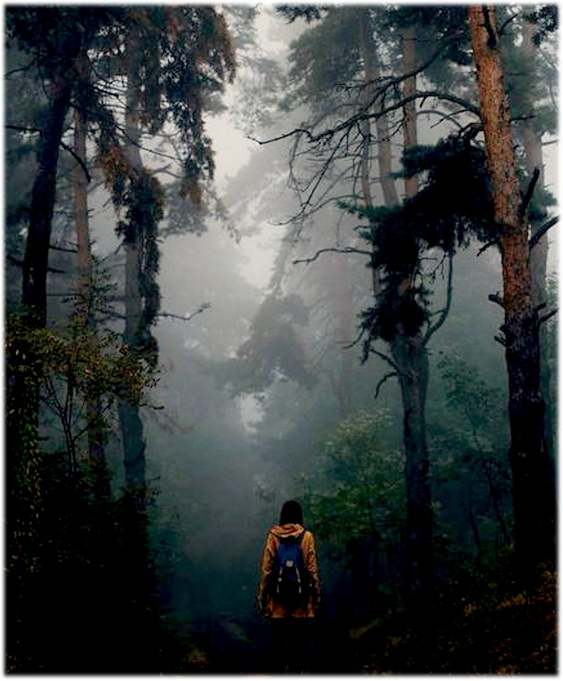
IF YOU’RE LOST IN THE WOODS AND ALL ALONE…
WOULD ANYONE HEAR YOU SCREAM?
A P S Y CH O L O G I CAL H O R R O R T H R I L L E R
FEATURE PRESENTATION
FROM WRITER / DIRECTOR ANDREW BOWEN

Slide 2
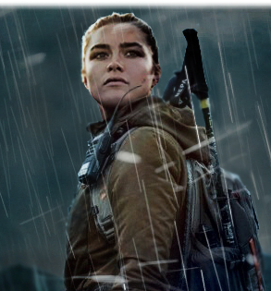
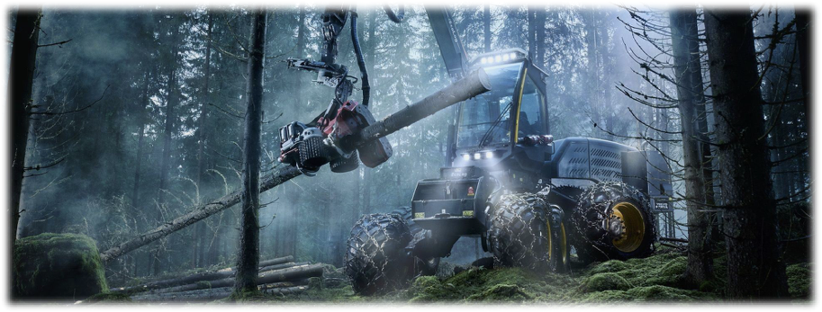
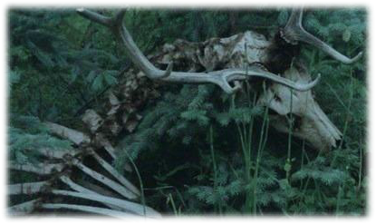
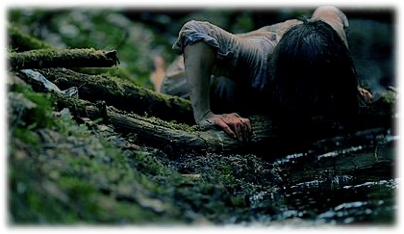
JAWS MEETS LIFE OF PIE
IN THE MOUNTAINS OF THE PACIFIC NORTHWEST

Slide 3
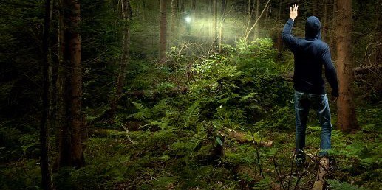
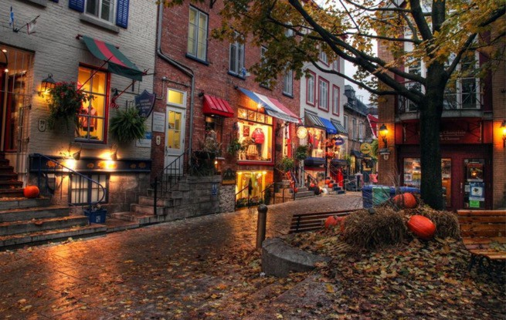
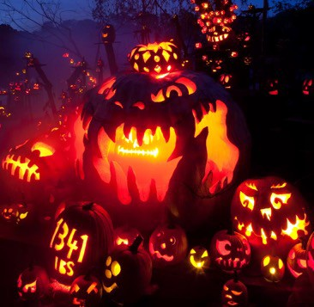
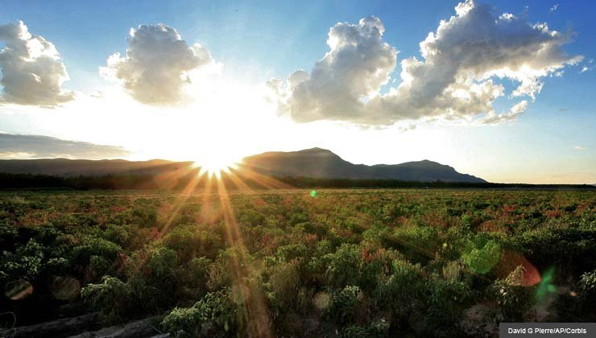
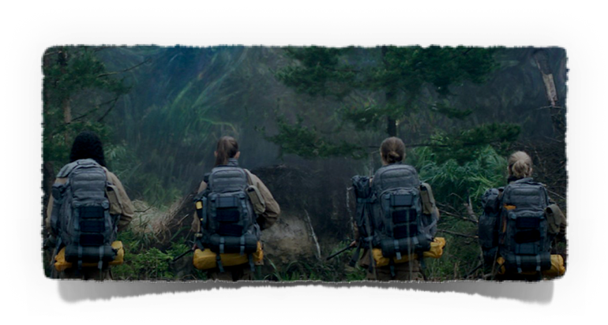
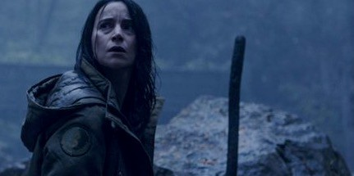
THE STORY & ITS WORLD
Set during the Fall, the film takes place in the picturesque city of Grimwood Falls. A small town whose quaint beauty is marred by “missing person” signs and a palpable sense of doom.
An eerie excitement fills the air as the town prepares for its Fall Harvest Festival - where giddy out-of-towners come to relish in the excitement of the town’s dubious history.
When a violent animal attack, leaves two locals brutally murdered just outside town, Wren (a local woman with a haunted past) is hired to assemble a small crew to track down and capture the animal ‘threat’ before the festival starts. An expedition that will send Wren’s team into a terrifying ‘fight for survival’ - when the very thing they were sent to find… Begins to hunt them.

Slide 4
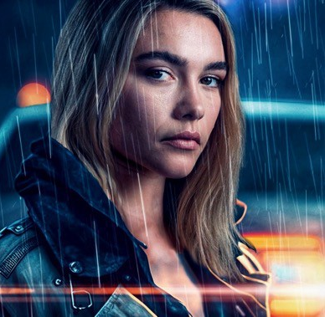
THE CHARACTERS
WREN RINEHEART
Our Ripley. Attractive, physically strong yet vulnerable, and deeply complex. Wren is a somewhat famous Grimwood local, whose parents were slaughtered when an animal attacked them during a camping trip when she was a child. An animal she believed was a Sasquatch. This event led Wren to become a cryptozoologist. Though disillusioned, lost and broken when we first meet her, Wren was born with an unbreakable will. Through great adversity and sheer grit she rises to overcome her own inner demons - to become the hero Grimwood needs.
BEN
An out of towner with a big heart (and a dark secret) Ben has had his share of bad luck in life. Having failed at multiple businesses in different towns, he’s come to Grimwood to try his hand in the logging industry. When tragedy befalls his worksite, Ben sets out to find redemption and justice.
MICHAELA
A spirited UC Davis student, Michaela became a Cryptozoologist because of Wren, whom she idolizes. An excited Michaela comes to Grimwood to share a discovery that could prove the existence of the elusive beast. Wren sees a younger version of herself in Michaela. Not wanting her to follow a path that left her empty and broken, Wren is determined to steer Michaela towards a better life.

Slide 5
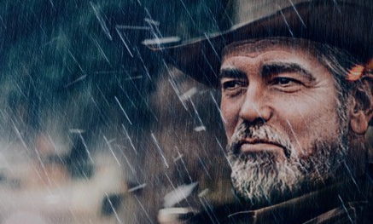
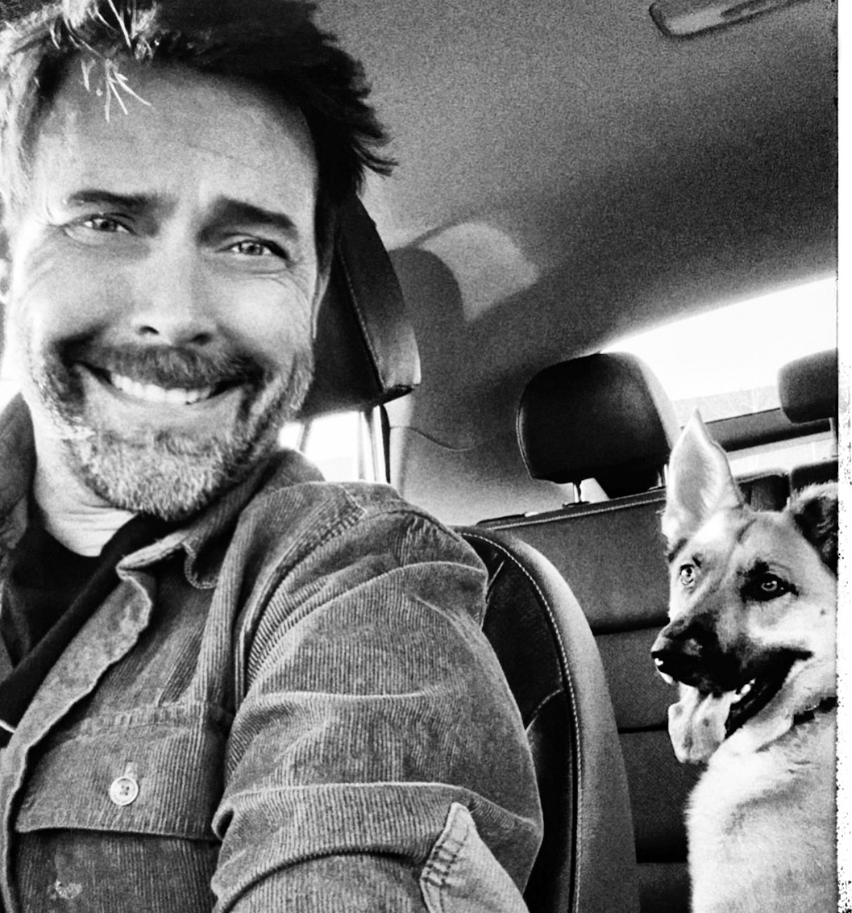
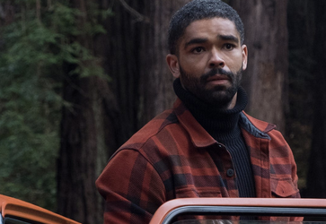
SHERIFF HOLDEN:
Grimwood’s top cop. A good man (with limited resources) doing his best to balance small town politics with what is ‘right’ to keep his Town and it's citizens safe.
JACE: A successful business owner, retired at 49 that now roams the country like a nomad with his German Shepherd, Bodhi. Jace connected with Wren years earlier - and drops by, from time to time. A good man and a trusted friend, Jace provides Wren some emotional support and humor (often through the crush he’s always had) and serves as a window to what Wren’s life might look like .. if she could let go of the past.
HUDSON: An experienced and renowned international large-game hunter who rubs Wren the wrong way. BAIT: Redneck trash Hudson brings to the team for muscle. As big as a gorilla and half as smart, Bait offers some levity to offset the tension in Act II KIP: A claims adjuster sent by the insurance company to make sure everything stays on the “up and up.” His goal is to ensure that the insurance company won’t have to pay the claim.
BODHI: Jace’s fiercely loyal dog who has a deep connection with Wren. He might be the thing that saves her life.

Slide 6
THE FILM ACT I
The film opens with a brutal attack on a young worker at a remote logging site. A violent attack that transitions into a mirrored ‘nightmarish’ flashback of a young mother being torn from the hands of her 8-year-old daughter.
The young girl, now in her mid thirties, wakes from the nightmare, gasping for breath. This is our heroine, WREN RINEHEART. A Grimwood local and cryptozoologist, Once passionate and optimistic, Wren is now a shadow of her former self living in the RV she calls home. The harsh realities of an unforgiving world and trauma left from her parent's vicious death, have left Wren broken. Though authorities claimed her parents’ demise was a “Bear Attack”, Wren was certain the beast was a SASQUATCH; a belief that launched her 25-year obsession to prove its existence. Though her graduate education made her a respected authority on Sasquatch lore, years of coming up empty-handed have left her disillusioned and broke.
Wren is a woman, haunted that she wasted her youth searching for ‘something’ that doesn’t exist - now just trying to make ends meet giving fruitless “Bigfoot Tours”.
When word of the brutal killing at the logging site hits Grimwood, it shakes the story's world. BEN GANNON, the site’s owner, distraught by the event, and on the verge of bankruptcy, is convinced a Sasquatch was responsible. Having an insurance rider to cover “Acts of God,” Ben files a claim to aid to his employee’s widow and keep his business alive. Inconsistencies in the autopsy leave Ben shocked that the claim is denied. The insurance company accuses him of fraud. Outraged by the accusation, Ben decides to finance an expedition to hunt down the beast and prove the company wrong, forcing them to honor the claim by providing physical proof.
Because of her obvious expertise, Ben offers Wren the opportunity to lead the expedition. She refuses, but after another attack and facing an impending foreclosure, Wren accepts.

Slide 7
ACT II
After assembling a local team that includes Hudson, Bait, Kip, and Michaela, Wren and Ben focus their search in the Otaktay Mountains; a treacherous, dense and unforgiving wilderness isolated from the surrounding forest by a deep gorge that encircles it. With only two ways ‘in’ or ‘out’, they plan to enter the region via Smugglers Bridge, a decaying relic from the prohibition era, track and capture the animal then meet Jace at the Northern Pass who will bring them home.
The exciting search begins. As a mother-daughter bond develops between Wren and Michaela, an unexpected storm hits the mountains - and the predator they were tracking kills a member of the team. Stripped of their gear and facing a threat for which they weren’t prepared, the team attempts to flee for their lives. But when they find the bridge destroyed by the storm, their only option out is to turn back.
Isolated and with no way to call for help, the team descends into a terrifying, white-knuckle night of anxiety and fear as the predator they were sent to trap begins to systematically hunt them down. After the team attempts to make a stand at a condemned mining shaft, Wren believes herself to be the sole survivor.
Pursued by the predator at every moment, Wren uses her knowledge of the woods, stamina and instincts to try and survive only to be knocked out blindly running into a tree.
Wren wakes - surprised she’s being carried by Ben. Despite being badly injured, he’s alive and bringing her to safety.
Arriving at the Northern Pass, they find Jace and Bodhi. After hearing of their terrifying ordeal, Jace quickly loads them into his EarthRoamer to flee. Exhausted - but safe and finally leaving Otaktay, Wren falls asleep.
Hours later, Wren wakes confused to discover that they’re still in woods and Jace has been violently slain. Before she has a chance to process what’s happened, she’s knocked unconscious.
She comes to, bound and gagged, to find Ben smiling ominously, sharpening his knife. Her world crashes down as she’s hit with the sobering reality that there was no Predator in the woods. It was Ben the entire time.

Slide 8
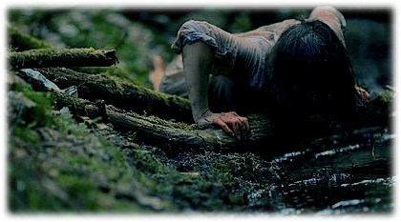
ACT III
Wren helplessly listens to him explain how he pulled off his elaborate ruse, taking advantage of her trauma and manipulating her into bringing a group of innocent people in the woods to satisfy his thirst for killing.
As Ben is about to kill his final victim, a ’Beast’ suddenly bursts into camp. Huge. Alien. Half-man. Half-ape. An insurmountable terror that is the thing of nightmares.
Ben runs to the EarthRoamer for safety as Wren helplessly watches the ‘The Beast’ that’s haunted her life, tear through the camp. When ‘The Beast’ unintentionally frees Wren of her bonds, she makes a dash for the EarthRoamer seconds before ‘the Beast’ SLAMS into it - causing it to land upside down, trapping them half submerged in the river. Wren escapes through a window and submerges into the water before the Beast tears Ben apart!Swept away from the carnage, Wren’s relief turns to terror when ‘The Beast’ sees her and charges. Moments before it can seize her, she tumbles over the edge of a waterfall.
Crashing into the lower river, the strong rapids pull Wren under the mountain, delivering her into a dark, cavernous cave. Barely able to catch her breath, Wren discovers she’s surrounded by animal corpses, bones and three JUVENILE BEASTS feeding on a human leg. She’s landed in the beasts’ DEN.
The Juveniles quickly see her and take pursuit. After barely escaping, Wren finds herself beaten, bruised and clinging to life in a frigid, new chamber. She’s horrified to discover it’s filled with human remains in various stages of decay; mounted to walls like TROPHIES. Her heart breaks when she discovers Michaela’s body among them.
Wren’s emotions peak when she uncovers a skeleton with her mother’s medallion around its neck. Not wrong about the creature that shattered her life, Wren decides to fight back. Quickly dispatching the juveniles, reinvigorated, powerful but in complete control, she creates an ingenious trap and neutralizes the beast.
Battered and barely alive, Wren emerges from the mountains, victorious.
Returning to Grimwood, Wren leaves Michael’s body at the steps of a hospital, then delivers the Beast’s severed hand to the authorities: evidence to support the ordeal she survived - and proof of The Beast’s, existence.
In the film’s final moment, Wren marches away from the police station, reborn a warrior. No longer scarred by her past, in control of ‘the beast’ within - and ready to lead the fight against this terrifying new threat.

Slide 9
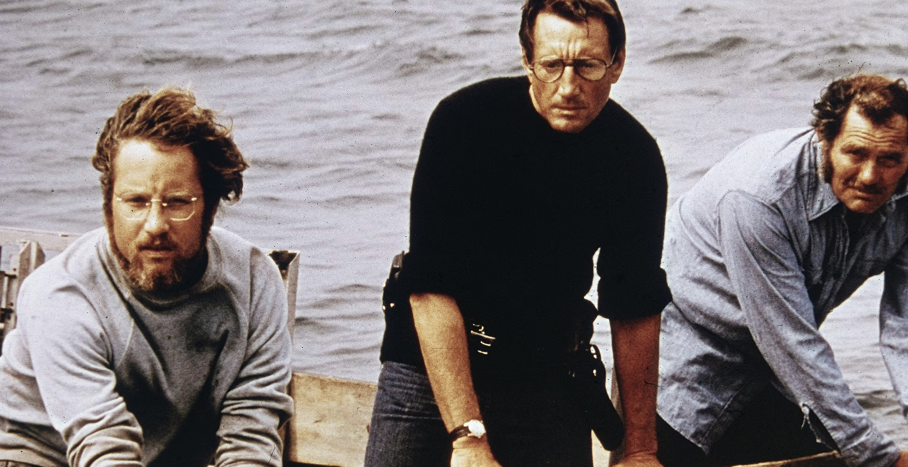
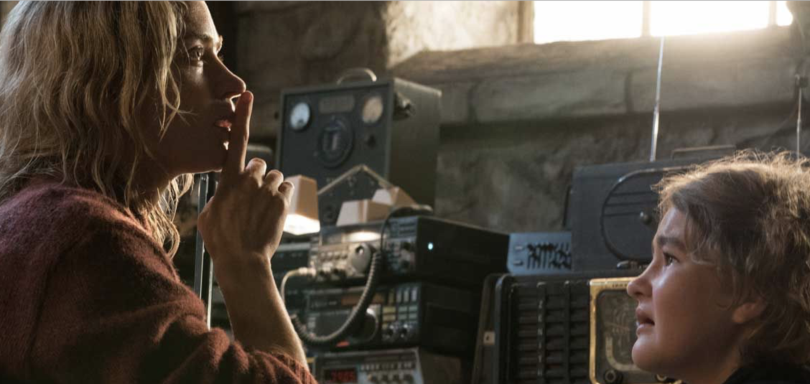
THE TONE
JAWS and A QUIET PLACE (with a nod to PREDATOR) are great examples of the tone and feel of Scent. Though the film is scary and disturbing at times - it also has moments of humor and action throughout. Our aim is to make SCENT a film that still appeals to audiences who aren’t horror fans. From frame one, we intend to build a truly scary, yet exhilarating movie-going experience, that’s still popcorn fun. It’s a lofty goal, but we want SCENT to do for 'camping in the woods’ what JAWS did for ‘going in the water’.
THE METAPHOR
The Ancient Greeks wisely instructed that one must “Know Thyself” in order to live a good life. Knowing oneself requires the uncomfortable act of going deep within. In heeding the call, Wren journeys deep into the woods to face the scary unknown that lies beneath (her traumatic past). After emerging from the baptismal waters of the Otaktay River and overcoming insurmountable obstacles in the inner cave of the Beast, Wren will conquer and control the animal within. A victory that ends her cycles of destruction and self-sabotage and allows her to be reborn - with her 'inner beast’ now being force for good in her life - and the world.

Slide 10
THE CREATIVE TEAM
Daniel C. Allison (executive producer)
Daniel C. Allison (DCA) is a surgeon and entrepreneur with an MD from Baylor College of Medicine and an MBA from Rice University Jones School of Business. He’s been an advisor, consultant, designer, and executive of companies ranging from start-ups to NASDQ blue chips. Born in London, England and raised in Tehran until the revolution of 1979, DCA and his family emigrated to the United States when he was six.
A world renowned orthopedic trauma and cancer surgeon, DCA practices at Cedars-Sinai and Children’s Hospital Los Angeles. Dedicated to the country that gave him so much, he is a Commander in the Medical Corps of the U.S. Navy Reserve and eployed to Iraq in 2018 as part of Operation Inherent Resolve.
Having close family ties, DCA was exposed to the inner workings of the film industry at an early age. His aunt was the pioneering make-up artist Dorothy Pearl and his uncle, iconic casting director Don Phillips. As a member of SAG/AFTRA, DCA has acted in several films, including Michael Bay’s PEARL HARBOR. Recognizing the positive and negative power of the film industry on people of all societies, DCA has a strong desire to make a positive impact on the world through film.
After DCA and Andrew Bowen’s successful venture of THE 716th, a sci-fi short officially selected to the 2018 Tribeca Film Festival, and winner of the 2018 Solzy Award for Best Sci-fi Short, DCA didn’t hesitate to act on another opportunity to work with Bowen on their latest project, SCENT. A well-crafted story with excitement, depth, and a message of overcoming self-doubt and sabotage to emerge empowered, the film falls right in line with DCA’s mission to deliver positive, productive content to the world.

Slide 11
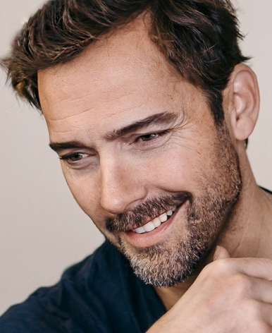
Andrew Bowen (writer, director, producer)
Raised on a steady diet of Marvel Comics, Science Fiction, Musical Theater and Action Movies from the 80's and 90's, Andrew Bowen is a multi-talented actor, writer, director and producer who's infectious passion for cinema, comedy and character-driven storytelling has been the driving force behind his more than two decades of work in the film and television industry.
After his hilarious debut as Jack Freemont in Capcom's live-action "Fox Hunt" game, AB become a series regular on Fox's comedy series Mad TV (where his impressions of Keanu Reeves and Nic Cage are legendary). AB continued to find success as an actor appearing in dozens of TV series, Independent Films and well over 150 national commercials. AB has worked with industry legends from Uma Thurman, Gale Anne Hurd (Aliens, The Walking Dead), James Mangold (IJ5, Logan) Lasse Hallström (What's Eating Gilbert Grape) and more. Some notable feature credits include roles in Blumhouse's Holidays, All For Nikki, Conjurer, The Work & The Glory (part 1 and 2) and Rock Jocks - appearances on Shameless, NCIS, NCIS:LA, Magic City, Leverage and more.
AB has lent his voice-over talents to brands from Lexus, Jeep, NAVY and McDonalds - and has been featured in some of the most successful video game titles of all time - including his work as Johnny Cage in WB's hugely popular Mortal Kombat X, MK11 and upcoming MK1.
An accomplished screenwriter and director, AB’s first feature 'Along The Way' (which he wrote, directed and starred in) was a film festival darling and award winner that debuted on Netflix. In 2018, AB returned behind the camera, writing, directing, acting, directing, editing (and serving as production designer) on the critically lauded comedic sci-fi, action-adventure short The 716th . Produced alongside DCA and JA, the short world premiered at the Tribeca Film Festival to audience raves and critical praise and was picked up by Amazon Prime.

Slide 12
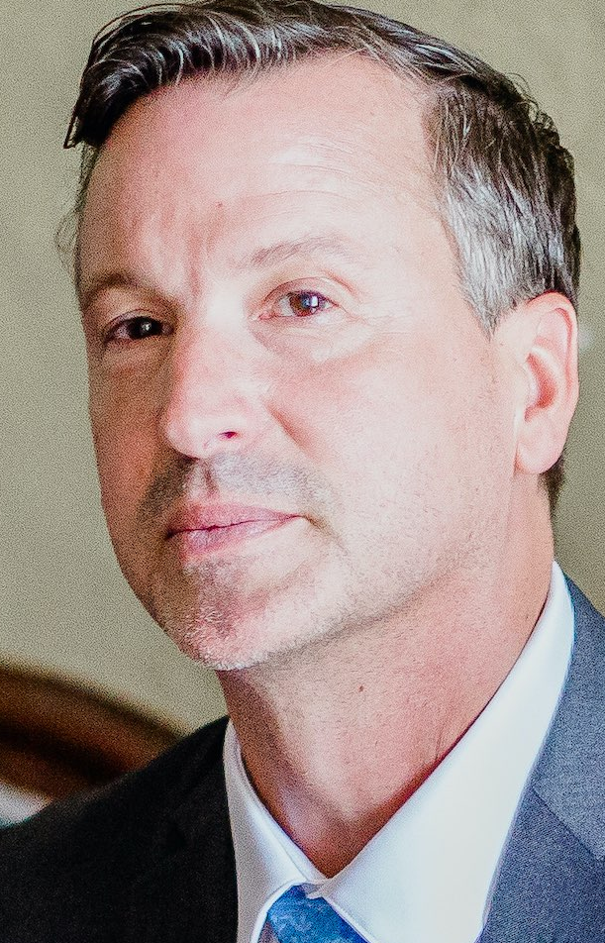
Jon Alvord (producer, VFX supervisor)
Jonathan Alvord is a visual effects supervisor and producer with over 30 years experience across production, post-production and education platforms. An award-winning artist, JA has received Emmy recognition for his work on HBO’s John Adams and led teams on projects for the NFL (Bring Down the House), Amazon (The Peripheral), Paramount + (The Offer), Apple TV+ (Shantaram), Screen Gems (True Haunting) and more.
Recognized for his mentorship skills, Alvord was recruited by Savannah College of Art & Design to become a Professor of Film & Television. There he post-supervised over 250 film shorts, including entries into Tribeca, Sundance, and SXSW. Additionally, he revamped their post-production and sound pipelines, brought advancements to the curriculums, and contributed to SCAD’s rise into the nation’s top 25 film schools.
Alvord partnered with Bowen and DCA on The 716th and is responsible for the logistical orchestrations of Anatomic Pictures’ technical pipelines and oversees post-production and VFX.
When not hiking the mountains of Southern CA with his wife, you can find JA meticulously working in his garage on his antique show car or completing construction on his vintage cafe racer motorcycle.

Slide 13
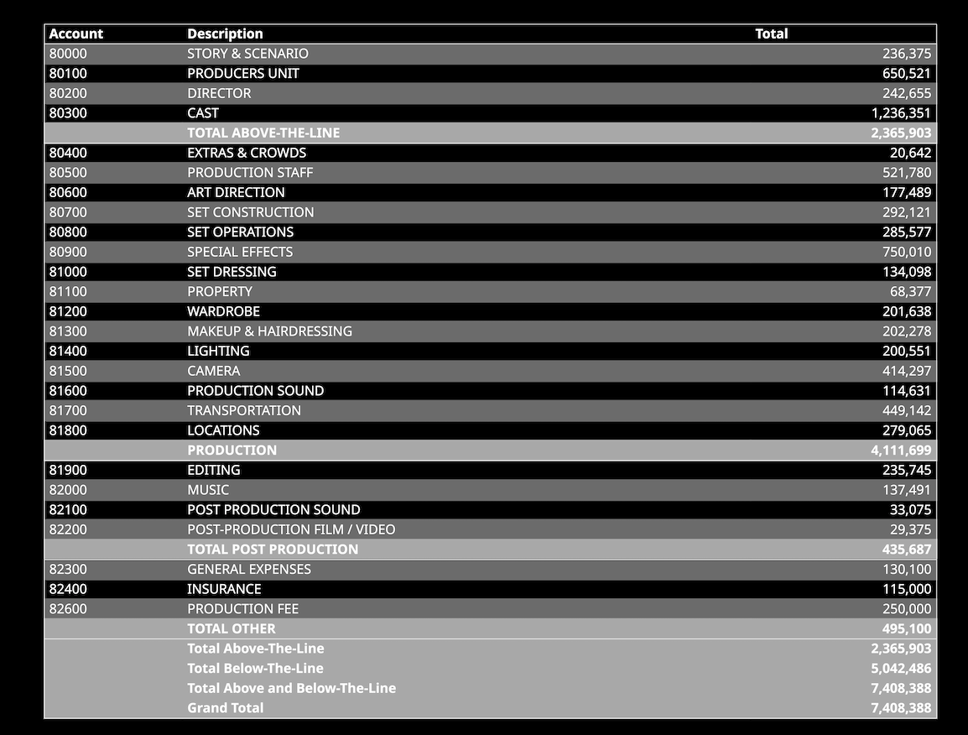
BUDGET TOP SHEET
Prepared by Carrie Lynn Certa
Producer(S): Daniel Allison, Andrew Bowen, Jon Alvord
PREP; 8 Weeks SHOOT: 25 Days POST: 12 Weeks
GUILDS/UNIONS**: SAG-AFTRA BASIC AGREEMENT RATES IATSE TIER 1 RATES
TEAMSTER TIER B DGA LEVEL 4A WGA HIGH **Prior to 2023 Negotiations

Slide 14
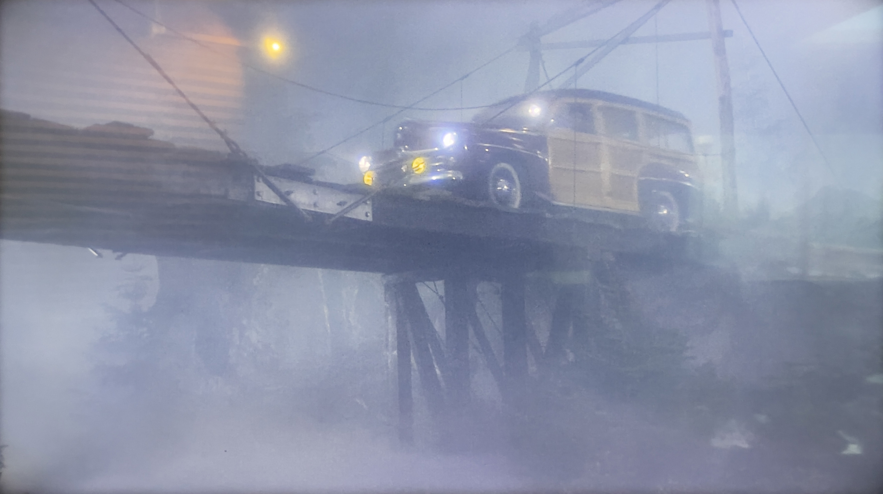
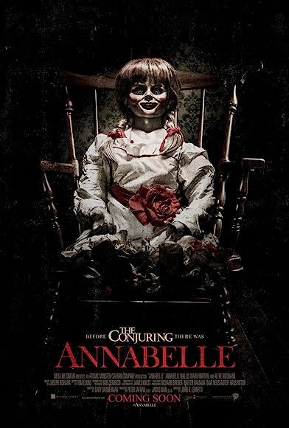
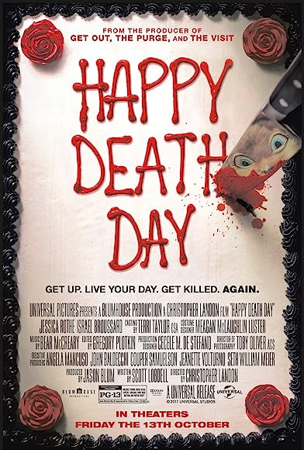
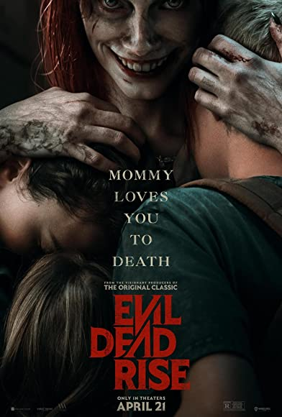
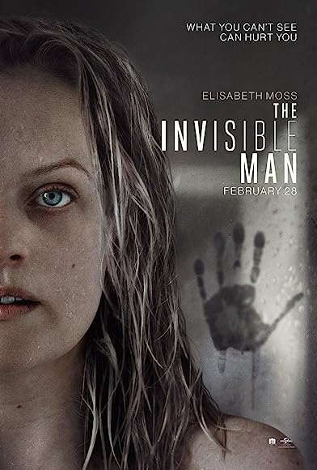
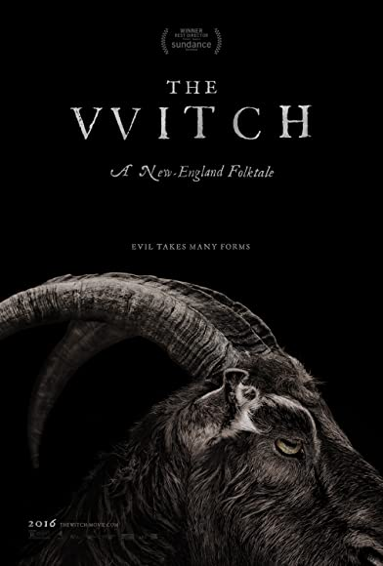
FILM COMPS
(2014)
Budget: 6.5M Gross: 257 Million
(2017)
Budget: 4.8M Gross: 125 Million
(2023)
Budget: 12M Gross: 146 Million
(2015)
Budget: 4M Gross: 40 Million
(2020)
Budget: 7M Gross: 144 Million

Slide 15
MARKETING AND DISTRIBUTION PLAN
Marketing
Target Audience
18 – 44 years old
Male and Female
Desire for a thrilling theater experience or an exciting night on the couch with someone close to hold
Vehicles
Social media (Twitter, Facebook, Instagram, etc.)
Film festivals
Promotional campaigns (create Sasquatch fever)
Traditional billboard, poster, television
Distribution
Standard theatrical release
Streaming services
Cable
Video on Demand
Ancillaries (airline, hotel)
Audiences are clamoring for an exciting, unpredictable, engaging horror film with depth, that makes them feel, makes them think, and leaves them grateful to be alive. SCENT fills this need. SCENT is not only going to be a great film but the inception of a franchise.
Executive Producer
Daniel C. Allison

Slide 16
Anatomic Pictures was launched in the fall of 2022. After the incredible success of Chris and Andrew’s first outing together (The 716TH) - they decided SCENT would be their next project together. Considering the current state of the industry & it’s aversion to producing original content (an idea that drove the innovation and storytelling of the 1980s and 90s) - they felt the ‘logical step’ was to form a production company.
Having worked with Andrew since USC (with thirty plus years of experience from pre- production, post and VFX), Jon Alvord was brought on board as a partner. Focused on creating original content, streamlined productions (at budgets well under industry standards), treating employees with dignity and respect, open to new ideas, risk taking and supporting creative vision - Anatomic Pictures aims to create a ‘new’ and ‘better’ business model for Film and TV development. A new brand - that will deliver fun, thrilling & successful storytelling for decades to come.
With Andrew’s library of close to 20 concepts, original IP and completed scripts - and the trio’s extensive industry experience and vast network of high level talent - Anatomic Pictures aims to be a fully functional production & development company within three years.

Slide 17
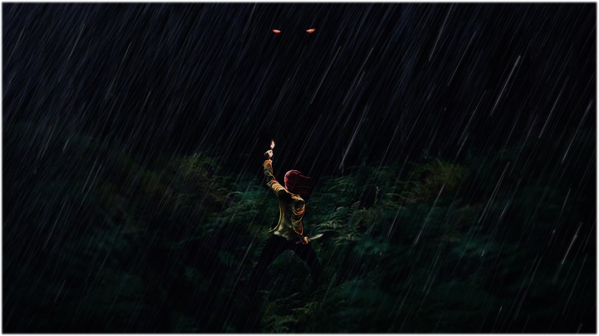
IF YOU’RE LOST IN THE WOODS AND ALL ALONE…
WOULD ANYONE HEAR YOU SCREAM?

